Slide 1
Morphology
Universidade Federal do Amazonas
Digital Image Processing
Profª Marly Guimarães
Allann Jones de Oliveira Silva

Slide 2
Boundary Extraction
Morphology

Slide 3
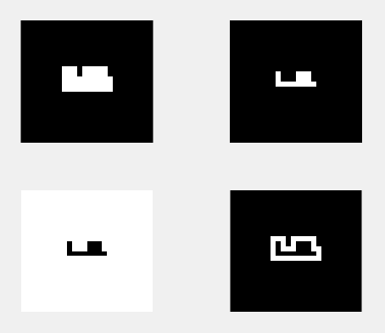
Boundary Extraction Definition
Boundary of a set A of foreground pixels:
β(A) = A – (A Ɵ B)
Where
A = Original image.
β(A) = A’s border.
Ɵ = Erosion operator.
B = Structuring element.

Slide 4
Hole Filling
Morphology

Slide 5
Holly Filling Definition
Each boundary enclosing a background region (i.e., a hole).
X_{k} = (X_{k-1} Ꚛ B) Ո I^{c} k = 1, 2, 3, ...
Until X_{k =} X_{k-1}
X₀ is the position of the boundary of the hole.
Ꚛ is the dillution operator.
B is a symmetric structuring element (SE).
Ո is the intersection operation
I^{c} is the complement of original image.

Slide 6
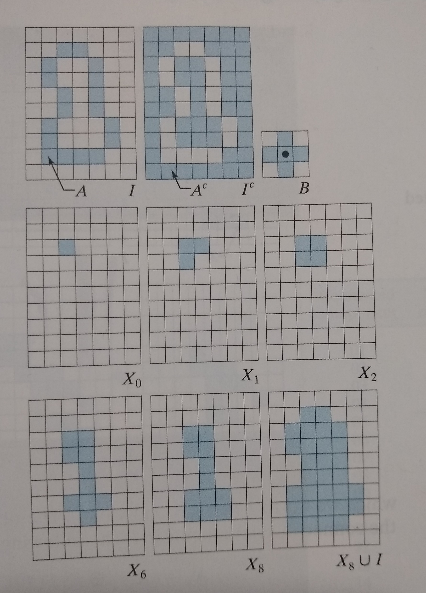
Boundary Extraction Implementation

Slide 7
Boundary Extraction Implementation
https://github.com/allanjos/image_processing/blob/master/master_degree/morphology/morphology_boundary_extraction.m

Slide 8
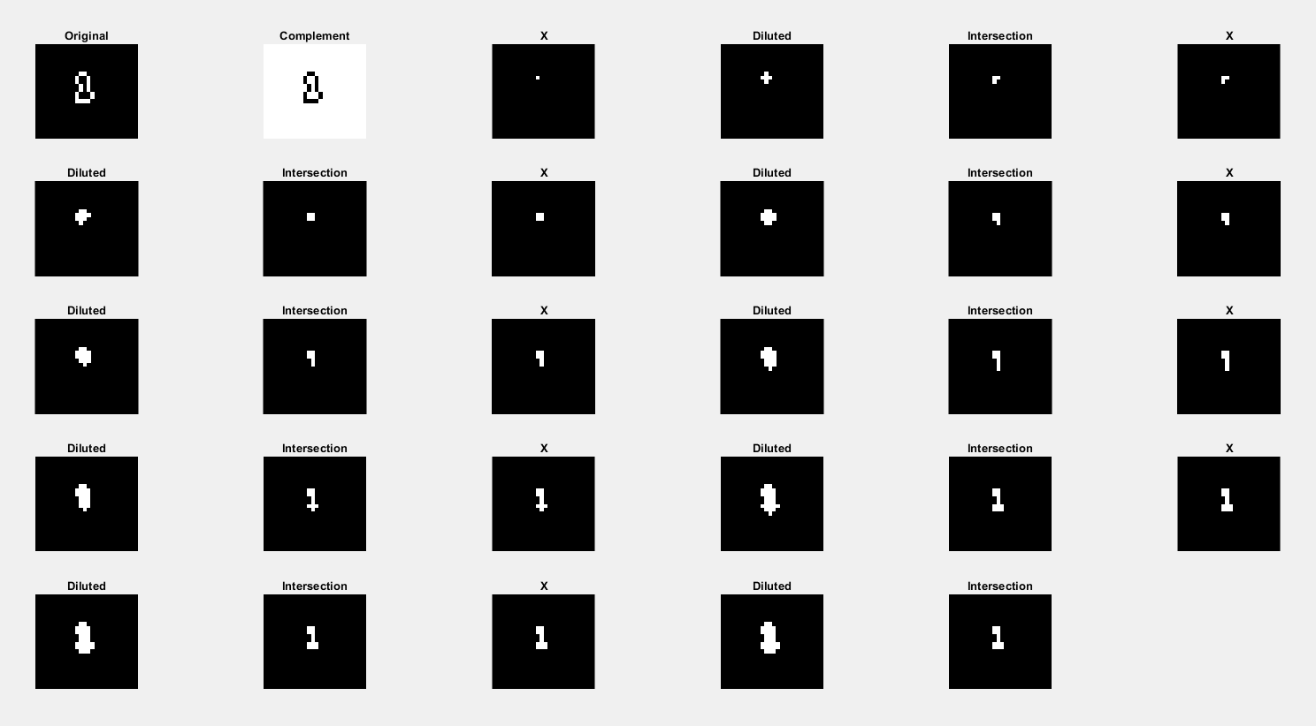

Slide 9
Extraction of Connected Components
Morphology

Slide 10
Extraction of Connected Components Definition
Extract connected components (foreground pixels) from a binary image.
Each boundary enclosing a background region (i.e., a hole).
X_{k} = (X_{k-1} Ꚛ B) Ո I k = 1, 2, 3, ...
Until X_{k =} X_{k-1}
X₀ is the position of the boundary of the hole.
Ꚛ is the dillution operator.
B is a symmetric structuring element (SE).
Ո is the intersection operation
I is the original image.

Slide 11
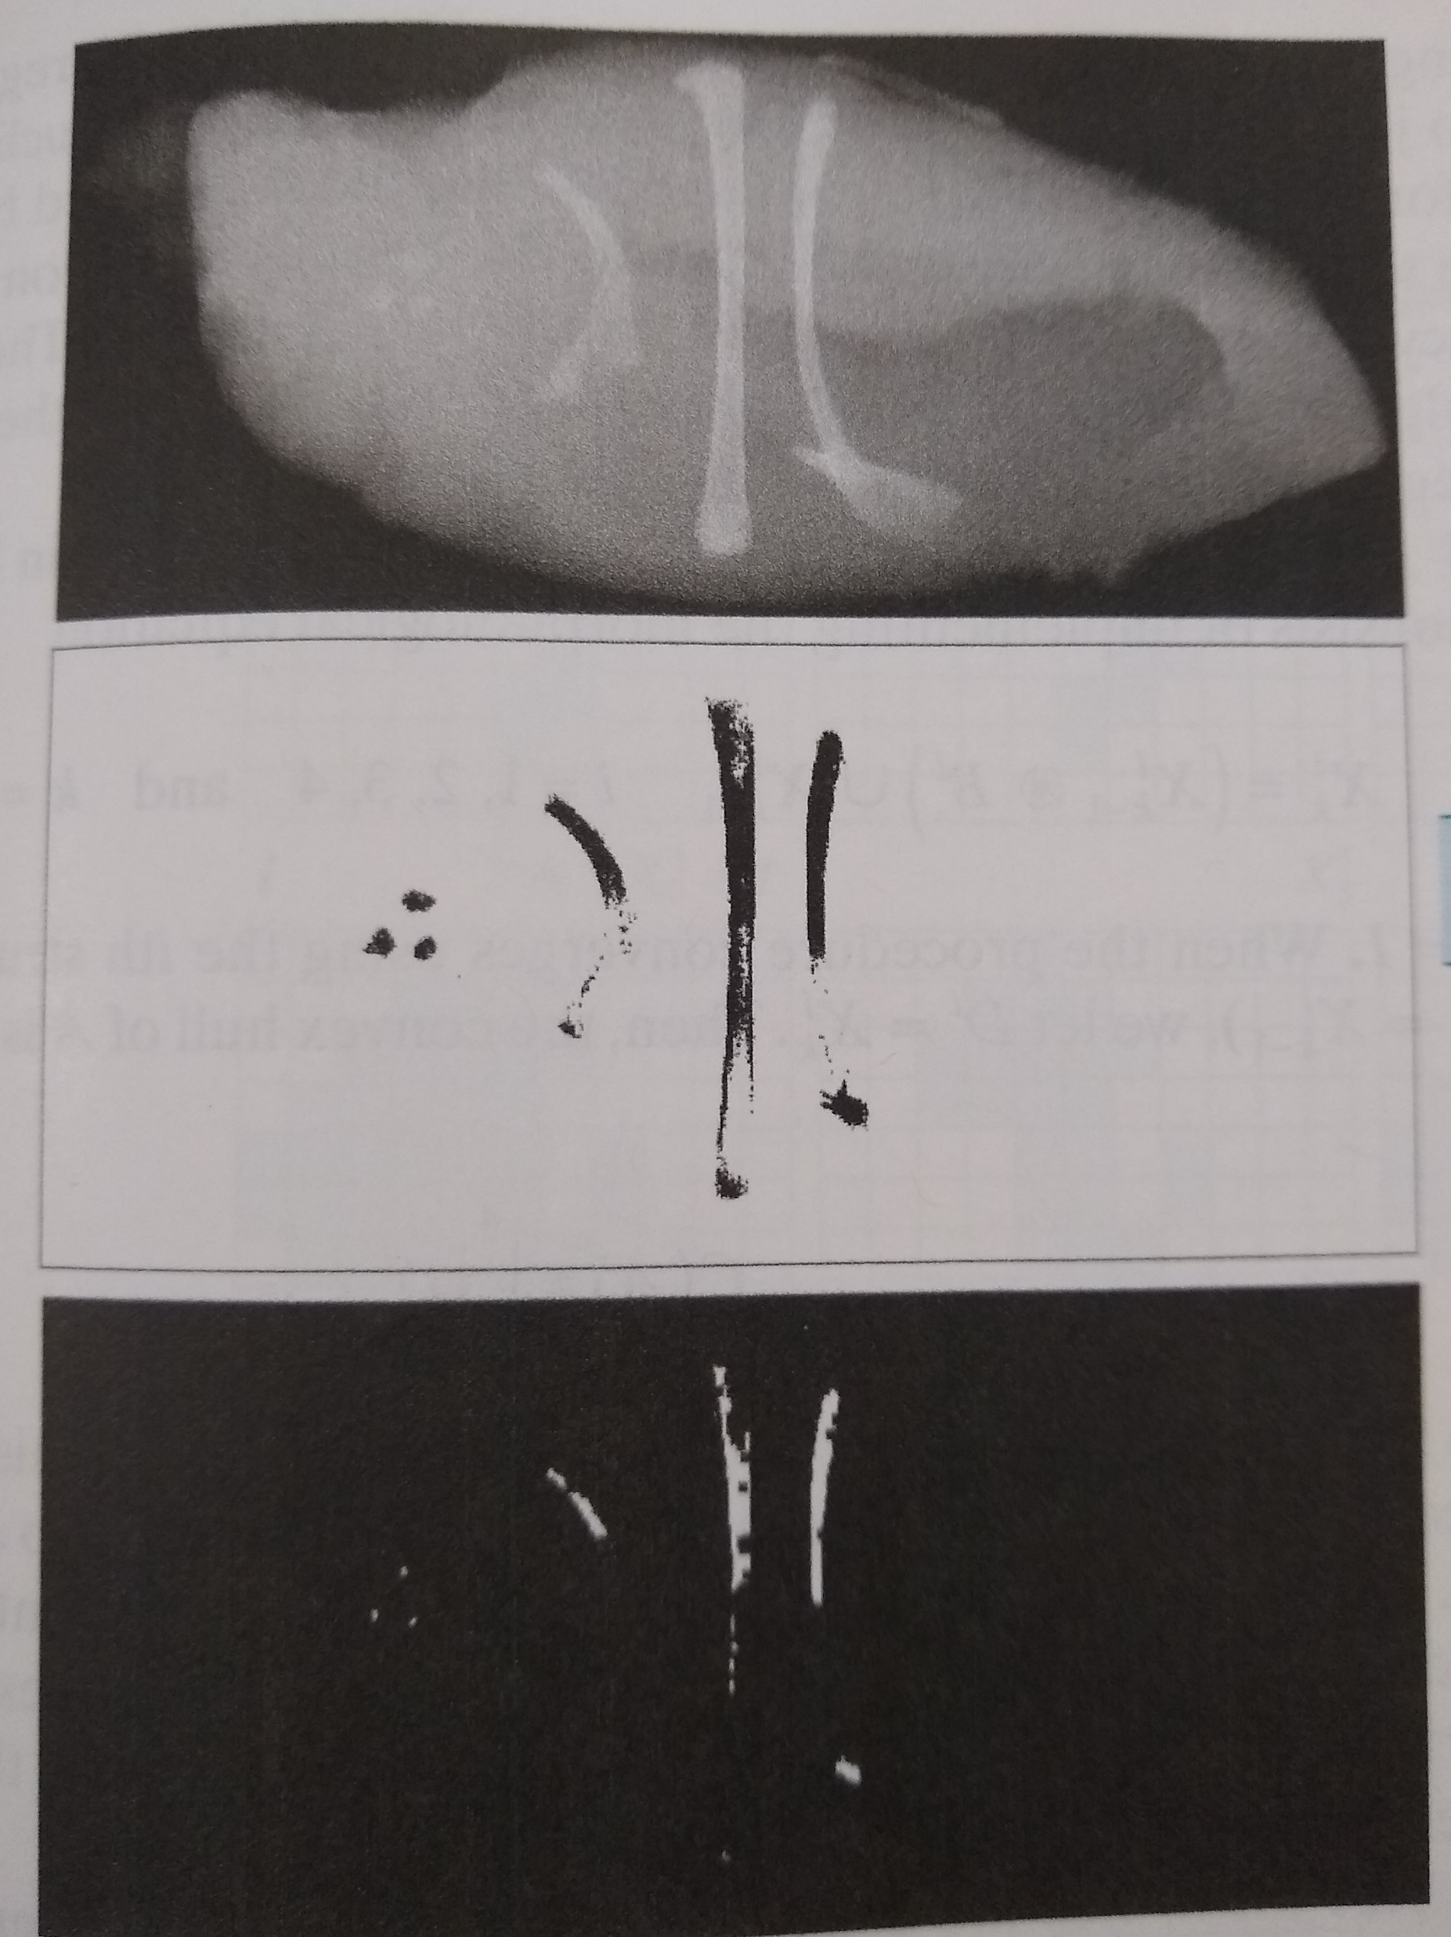
Extraction of Connected Components Application

Slide 12
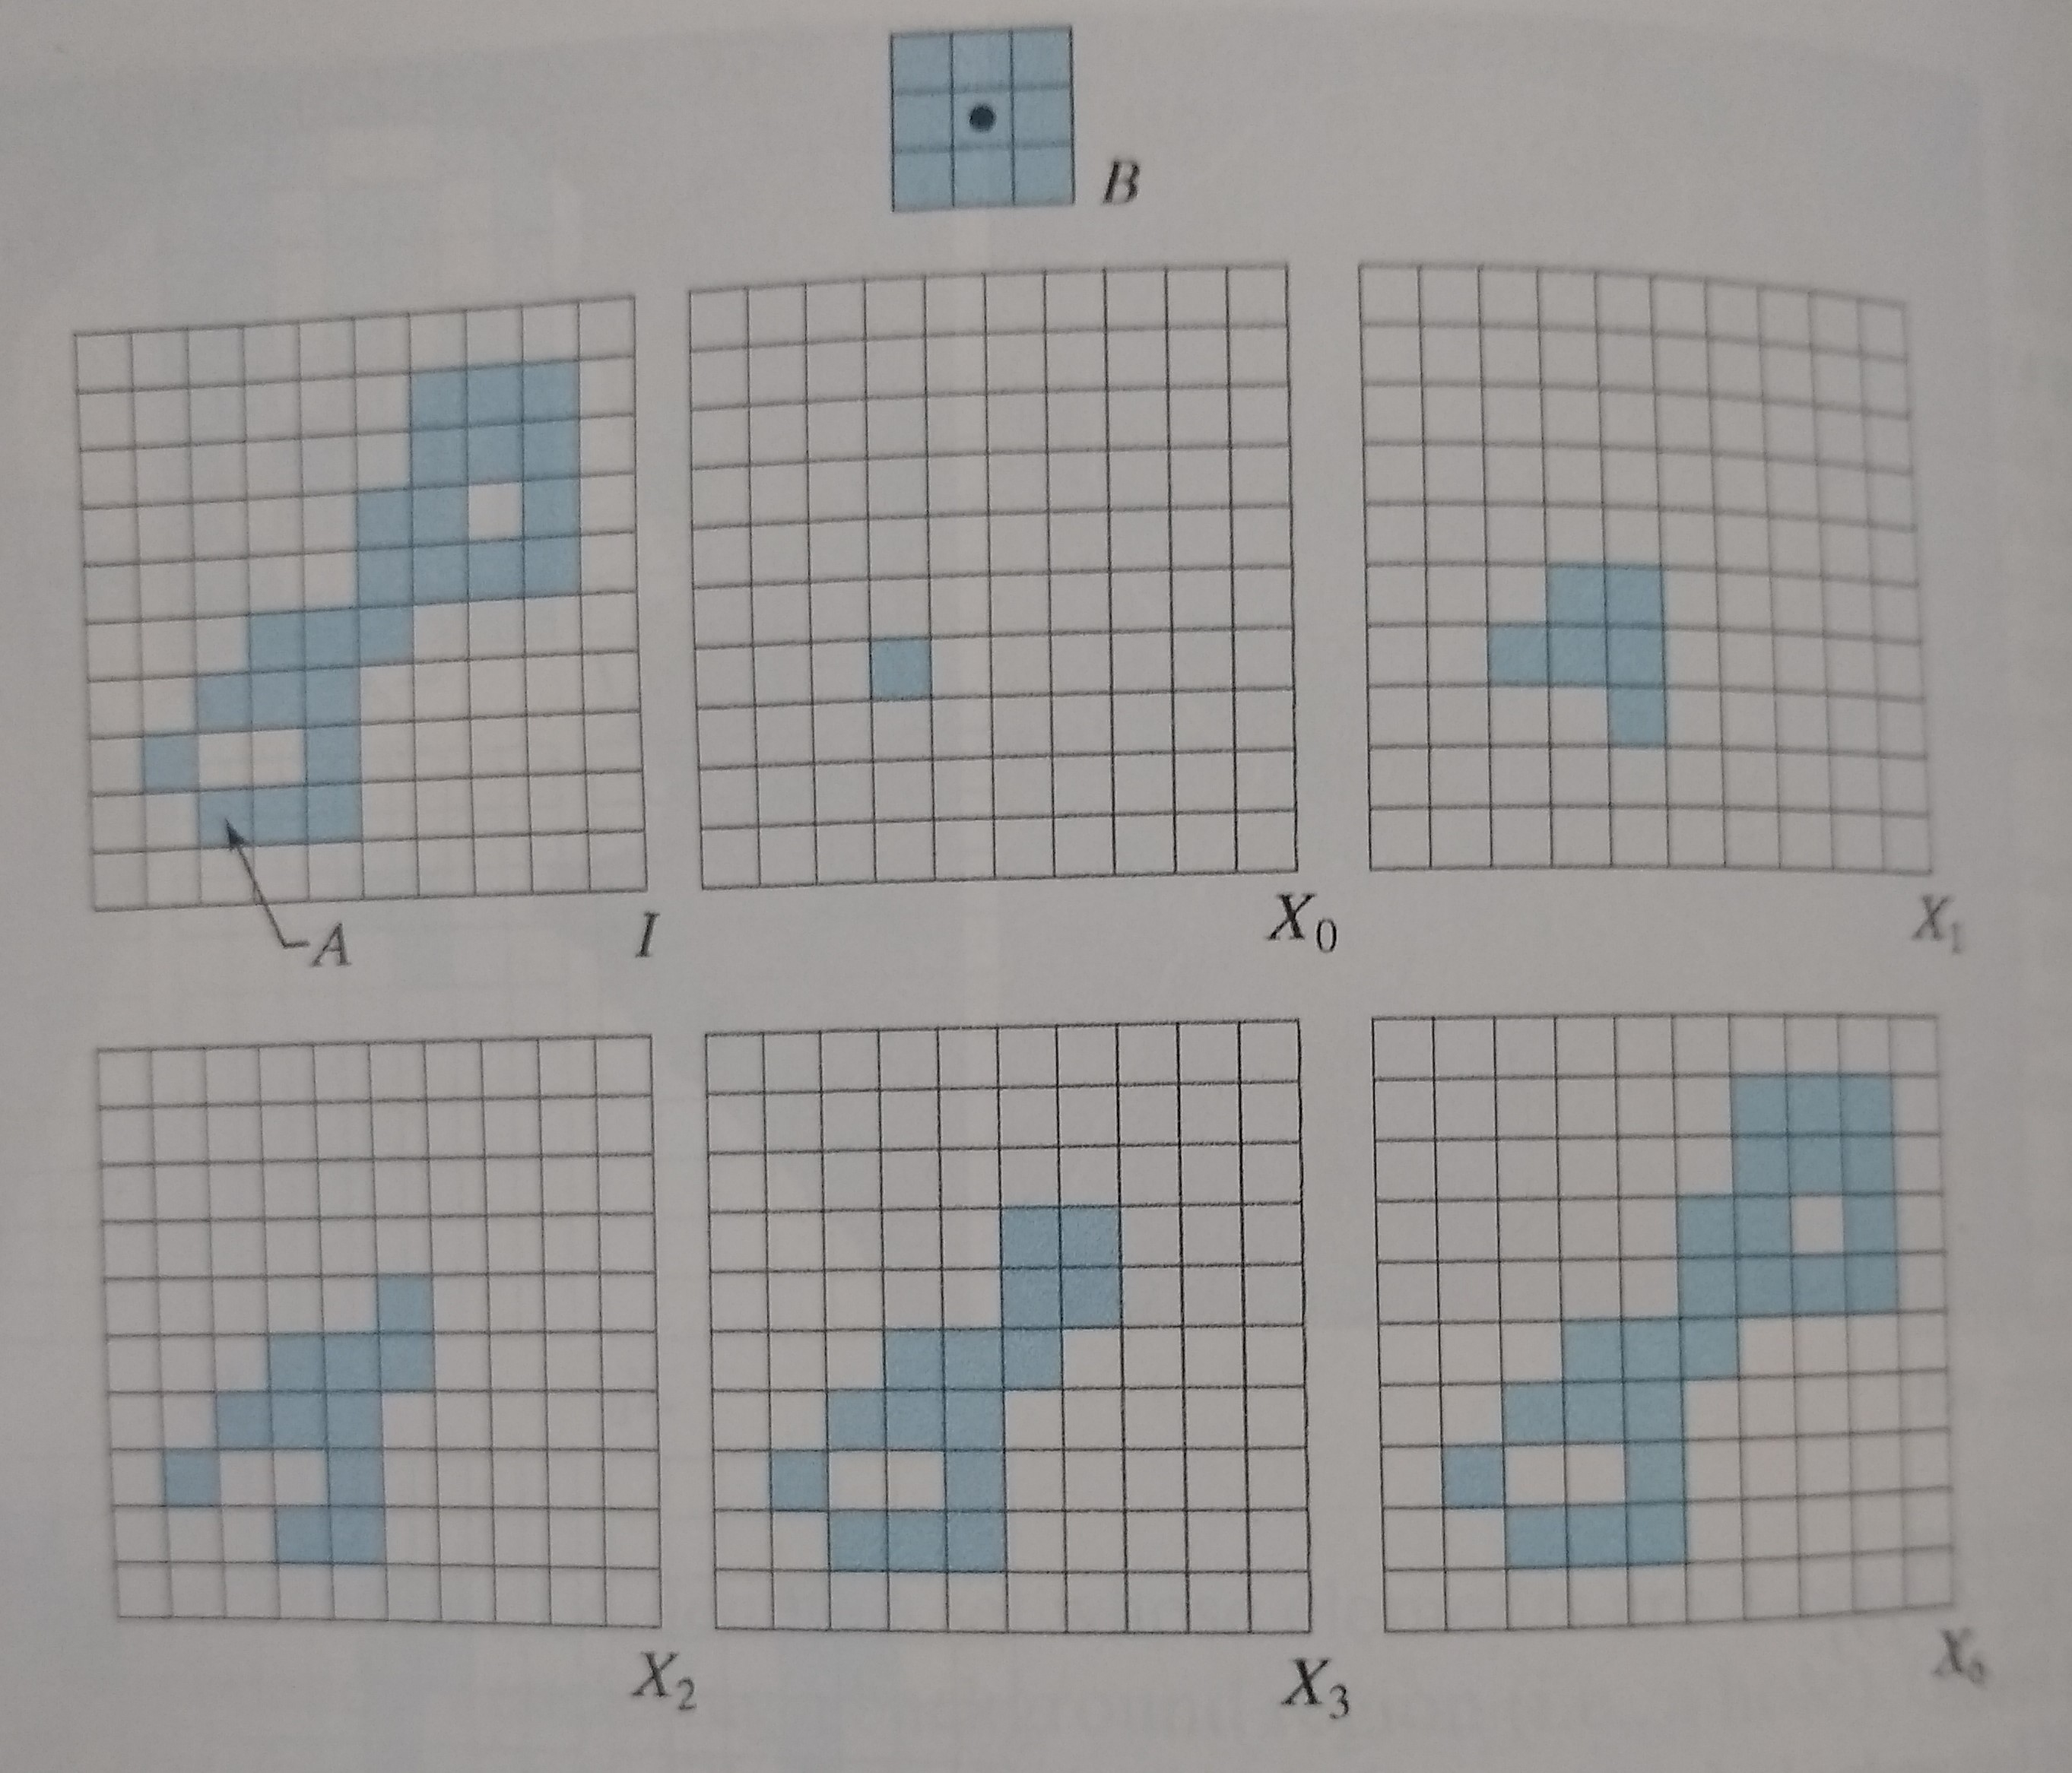
Extraction of Connected Components Implementation

Slide 13
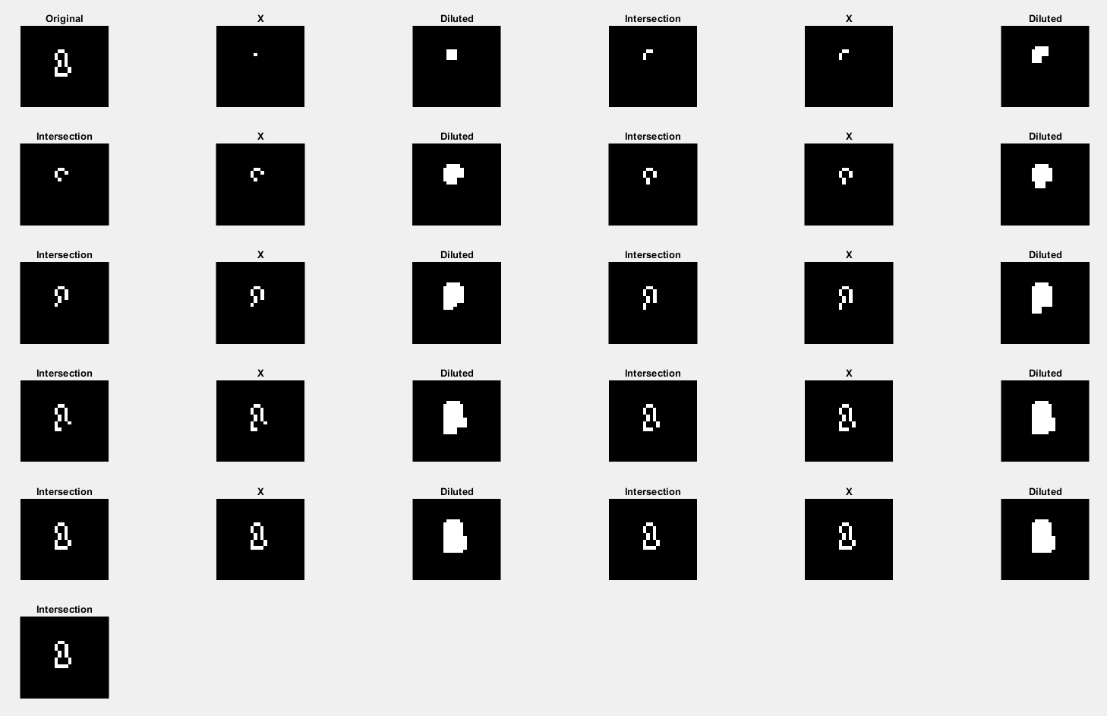

Slide 14
Extraction of Connected Components Implementation
https://github.com/allanjos/image_processing/blob/master/master_degree/morphology/morphology_extract_connected_components.m

Slide 15
Convex Hull
Morphology

